Slide 1

COMPARISON human vs animals

Slide 2
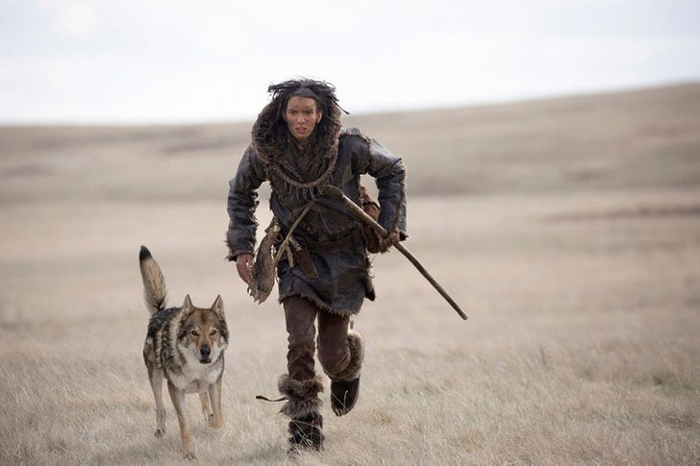
Comparing Human and Animal
When we are comparing two or more categories, the main thing to do is we note the attributes that are different from one category to other.
On the basis of different attributes we can form groups and classify them.
For example we will compare human and animals and from this comparison we are to distinguish between animal and human

Slide 3

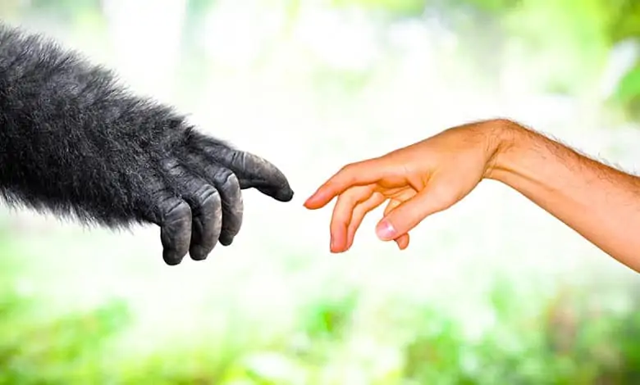

Difference Between Human & Animals
Humans
Animals
Humans belong to the species “Homo sapiens”
Humans are omnivores..
The average human brain weighs 1.2 kgs.
Just like animals, humans are also driven by instincts. However, we can also reason.
Humans have “true language” to express themselves.
Animals cover a number of species.
Most animals are either herbivores or carnivores. Animals like bears are omnivores.
Brain size varies across species – with the largest ones weighing in at 6.92 kgs (blue whales) and the smallest ever belonging to the ragworm, measuring just under 180 micrometers across
Animals are primarily driven by instincts.
Animals communicate with each other; however, none have the complexity nor the expressiveness of the human language.
Notes:
Photo by Charles Wundengba
on Pexels

Slide 4

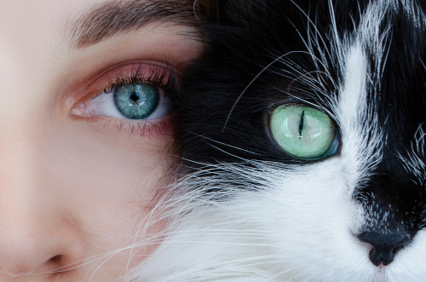
COMPARISON CHARTS
Definition
Communication
Ability
Shelter
Humans are the member of the species Sapiens with the highly developed brain, belongs to the vertebrates.
Humans can talk. They communicate through various languages.
Humans can change the environment according to their needs..
Humans are capable to make houses or buildings for their shelter.
Animals are the member of kingdom Animalia with a multicellular body, specialize sense organs and an undeveloped brain
Animals do not have any particular language, have very basic communication skills. They use sounds to communicate.
Animals are incapable of changing the environment, they have to adapt or die.
Most of the animals live in the natural environment, in the jungles.
Notes:
Photo by Charles Deluvio on Unsplash

Slide 5
Difference according to body appearance
01
02
03
04
Communi
catoin
No. of Arms and legs
No.of eyes
Walking
Humans have some basic communication means to coomunciate with each other and have specfic language to communicate, but animals do not talk
Humans have two legs and two arms but animals does not have any fixed number even some animals does not have any legs and arms like snakes
Humans have two eyes whereas animals eyes can vary like spider have eigth eyes
Humans are bipedal where as some animals crawl,some do walk, some fly in the air and some swim

Slide 6
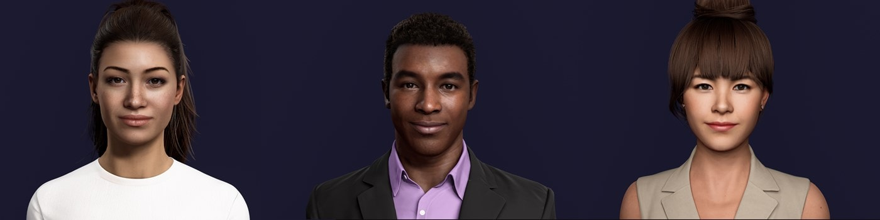
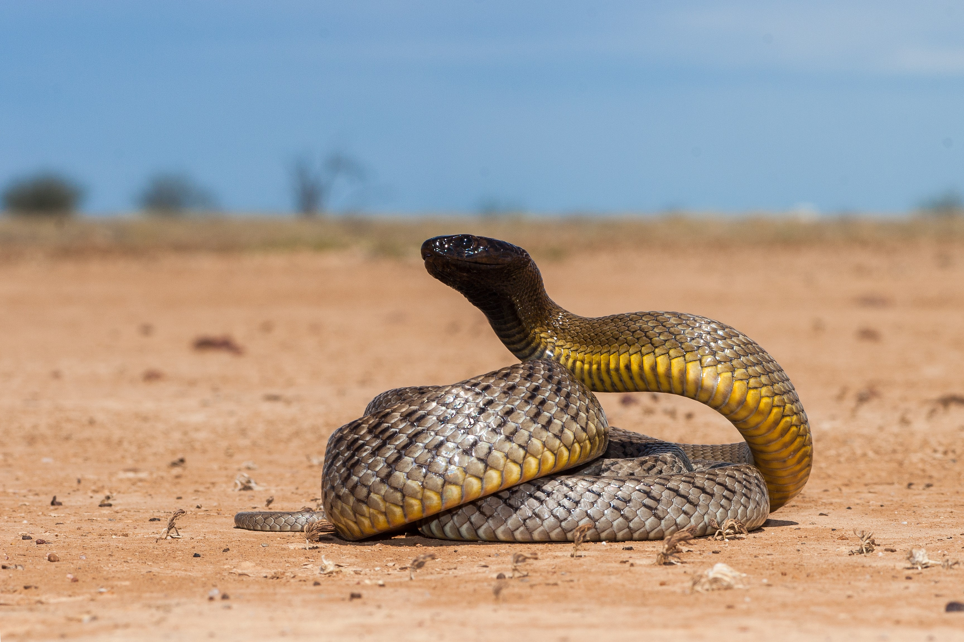
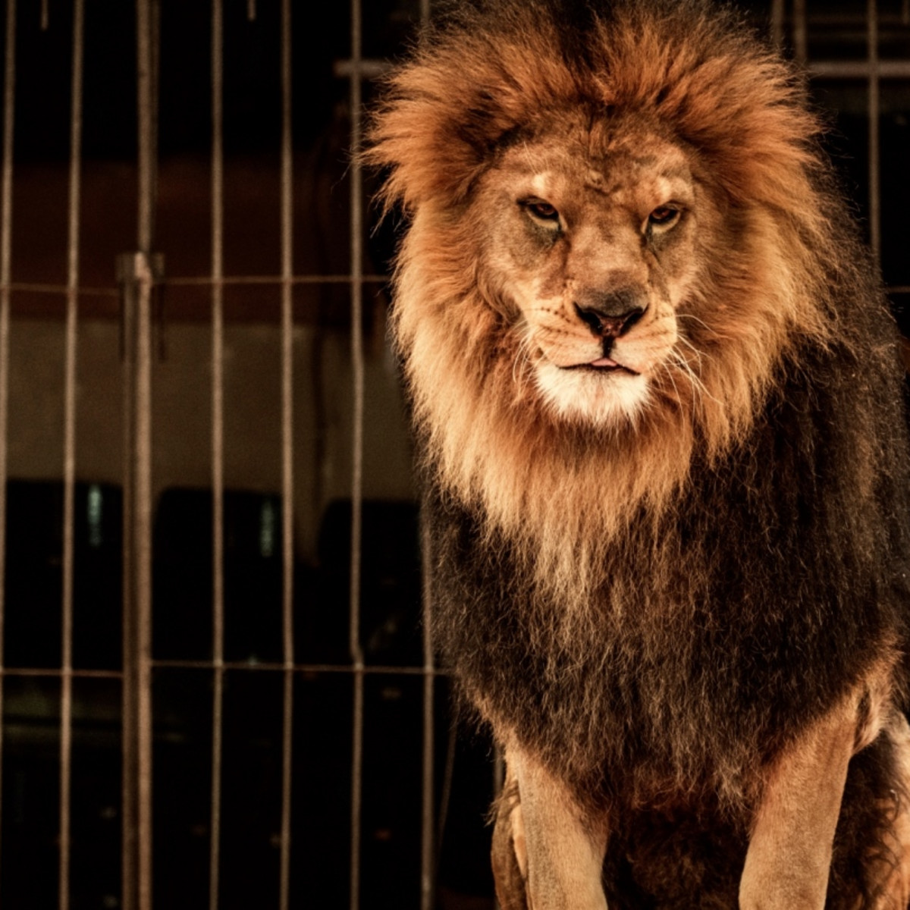
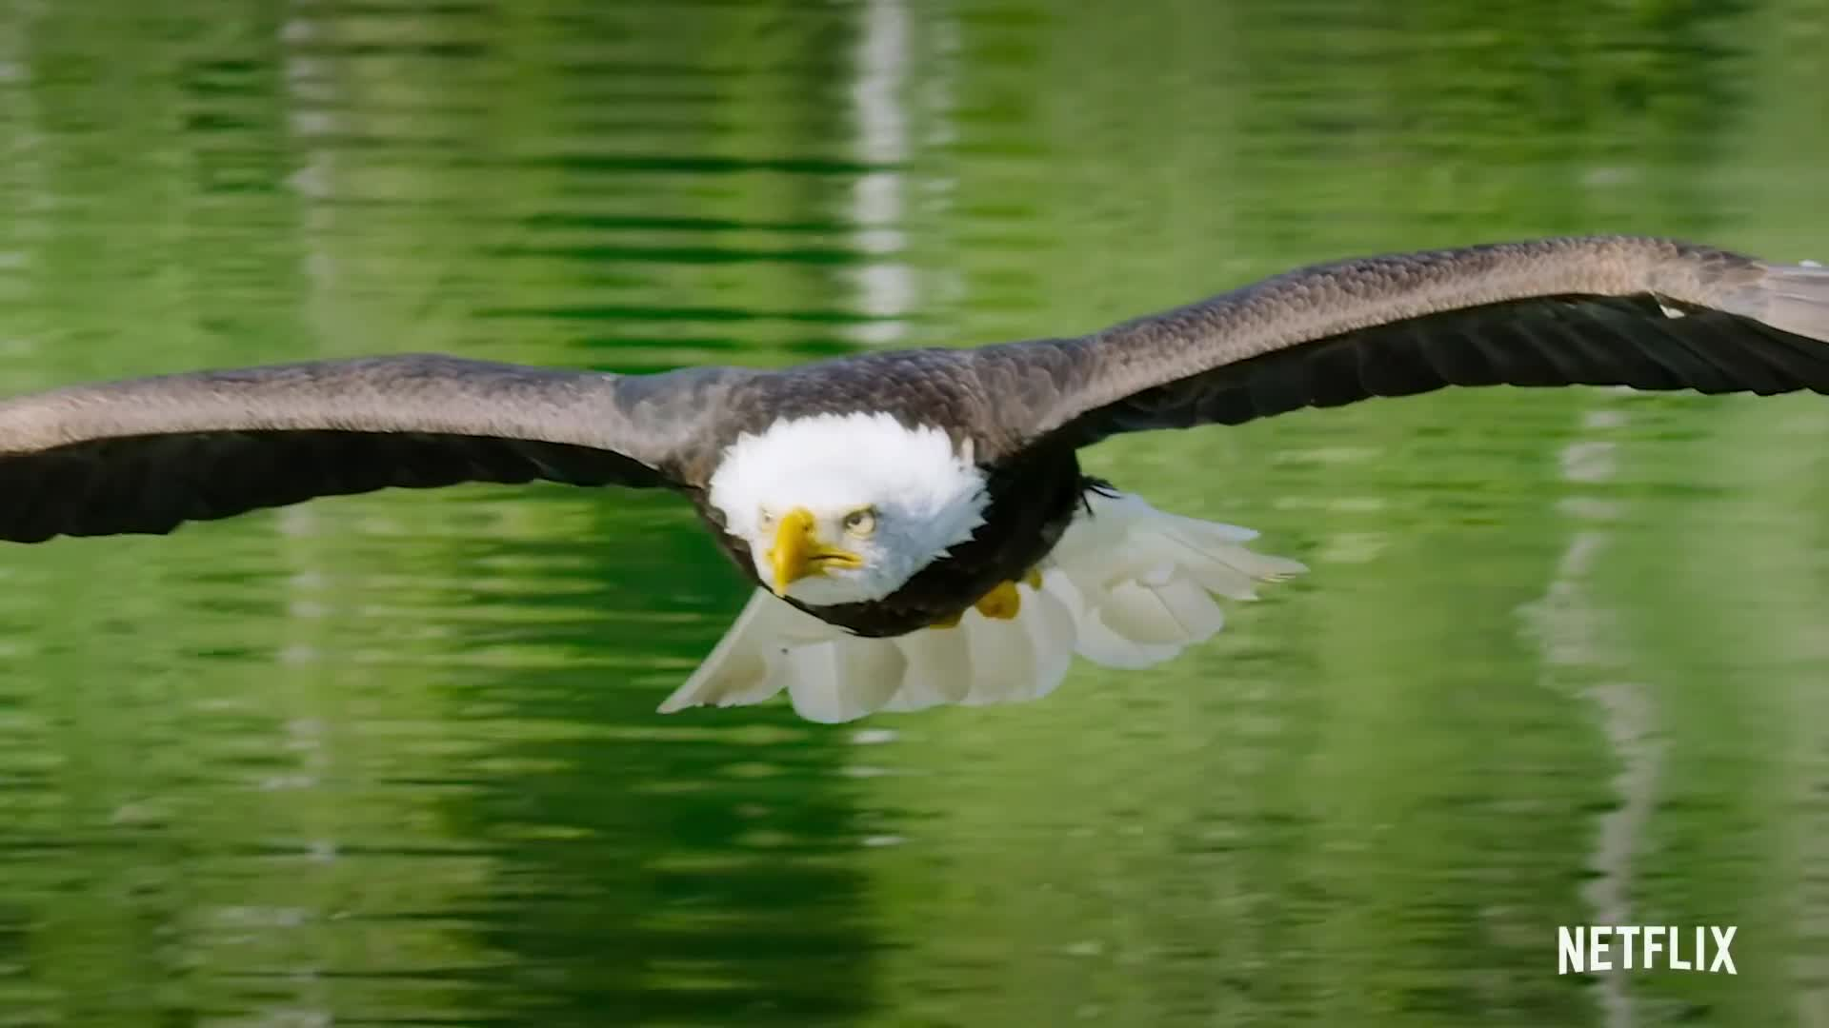
Humans
Animals

